Slide 1

CAPSTONE PROJECT
CLASSIFICATION OF EMAILS AS HAM OR SPAM
Presented By
Student Name: PRIYADARSHINY DAS
College Name: TECHNO MAIN SALT LAKE
Department: COMPUTER SCIENCE AND ENGINEERING- CYBER SECURITY
Email ID: sribashchandradas57@gmail.com
AICTE Student ID: STU6761195c3ea191734416732

Slide 2
OUTLINE
Problem Statement
Proposed System/Solution
System Development Approach
Algorithm & Deployment
Result (Output Image)
Conclusion
Future Scope
References

Slide 3
Problem Statement
In today's world, email (electronic mail) is one of the most prevalent forms of digitial. Almost all online sites and portals use emails to communicate with and notify their users, and mainly to announce any promotions or extend offers. For the purpose of advertising, several unsolicited, junk mails are sent in bulk, known as 'spam mails'. Spam mails clutter inboxes and can also pose huge risks as they may contain malicious attachments or links which download malware (viruses, ransomware, spyware, etc.) on the recipient's device on being clicked. Such mails are used for identity and data theft, which can be used to cause financial losses and severe damage to reputation. It is therefore extremely crucial for users and systems to detect/recognise spam mails and filter/delete them.

Slide 4
Proposed Solution
The proposed solution aims to address the issue of detecting spam mails to put them away in a separate folder and prevent the user from clicking on them. This involves leveraging logistic regression and machine learning techniques to classify emails as ham (non-spam) or spam accurately by studying the catchwords. The solution consists of the following components:-
Data Collection:
Gathering datasets containing emails classified as ham or spam.
Data Preprocessing:
Preprocessing the collected datasets manually to remove any missing values.
Balancing the unbalanced datasets.
Performing feature engineering to extract the features of the data in a numerical form for the machine learning model to understand and learn.
Making the model ignore stopwords to increase effectiveness and efficiency.
Machine Learning Algorithm:
The machine learning algorithm implemented is Logistic Regression.
Deployment:
The entire project and all related documents and links have been deployed to GitHub.
Evaluation:
Assessing the model’s performance based on accuracy score, average accuracy score, Mean Absolute Error, Squared Error, Root Mean Squared Error, F1 Scores, and Confusion Matrix.
The performance of the model was evaluated based on accuracy scores, Mean Absolute Error values, Mean Squared Error values, Root Mean Squared Error values, Classification Reports, Confusion Matrices, and F1 Scores.
Result: Average accuracy score is greater than 98%.

Slide 5
System Approach
SYSTEM REQUIREMENTS:-
HARDWARE REQUIREMENTS:-
CPU: Multi-core processor (Intel i5)
RAM: 8-32 GB
Storage: Solid State Drive/Hard Disk Drive (minimum 100 GB)
GPU: 8-32 GB
Network: Strong internet connectivity, 160 Mbps.
SOFTWARE REQUIREMENTS:-
Operating System: Windows/macOS/Linux
Programming Language: Python (version 3.6 or higher)
IDE: JupyterNotebook/Google Colaboratory/PyCharm/Visual Studio Code
Package Manager: pip, conda
Dataset: labelled dataset containing email bodies/subjects classified as ham or spam.
Libraries required to build the model:-
Math
Pandas
Numpy
Matplotlib
Seaborn
Scikit-learn
LogisticRegression
String
NLTK
wordcloud
warnings

Slide 6
Algorithm & Deployment
Algorithm Selection:-
Selected algorithm: Logistic Regression.
Logistic Regression is a supervised machine learning algorithm particularly used to solve binary classification problems. It uses a sigmoid function to estimate the probability of an event occurring based on the training data and the input features. It does not directly predict a category/class label, but produces a probability value between 0 and 1, This probability value is then compared to a threshold value. If it is higher than the threshold value, it predicts the positive class, otherwise the negative class.
This algorithm was selected due to its simplicity, high efficiency, and interpretability, making it a suitable choice for various classification problems. It performs well with high-dimensional datasets, such as those created from text data, where each word can be a feature. It helps identify which factors are most influential in determining the outcome, providing valuable insights into the data. It provides clear insights into feature importance and the model’s performance, which are valuable in decision-making and for assessing the model’s overall capability respectively.This algorithm can achieve high accuracy levels, sometimes exceeding 99% if the data is clean and well preprocessed. This is an important factor as spam mails need to be correctly detected as they pose several serious threats to privacy and data safety.
Data Input:-
Four datasets (with ‘.csv’extension) of email records, each having two labelled columns, were selected. One column contains the email body/subject, and the other column contains the email’s category (0(ham)/1(spam)).
Three of those datasets were considered for input, and one of them was used for testing the model.
The TF-IDF technique is used to convert text into numerical feature vectors.
The algorithm mainly uses the presence of spam keywords and word frequencies as input features.
Training Process:-
After balancing the preprocessed datasets, they are split into the training and the testing subsets and their features are extracted. The model is then made to learn these features and apply the transformation, after which it predicts the probable category of the emails.
Prediction Process:-
The model takes into consideration the input features and applies the transformation process to the unseen data to convert it into a feature vector. This feature vector is then used to predict the probability of the email being spam or ham on the basis of a threshold value.

Slide 7


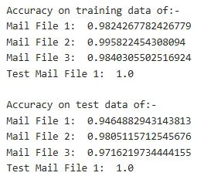
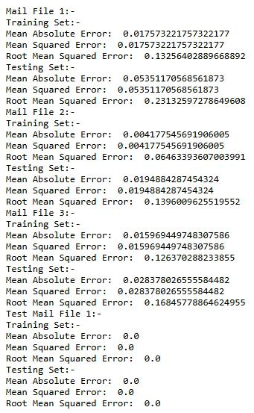
Result
SCREENSHOTS OF RESULTS

Slide 8
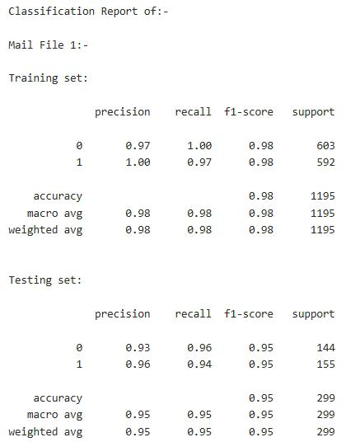
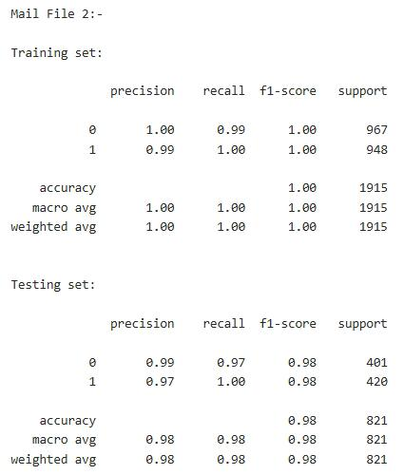
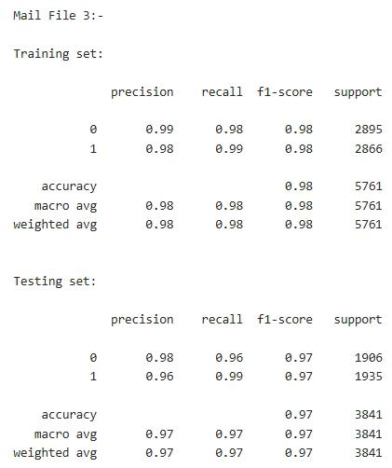
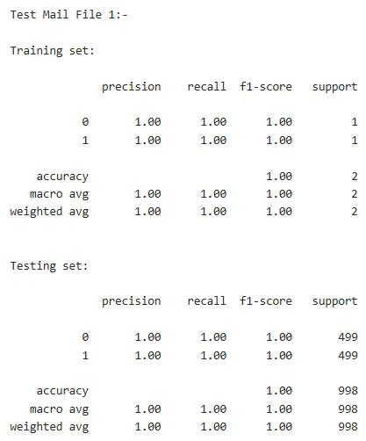

Slide 9
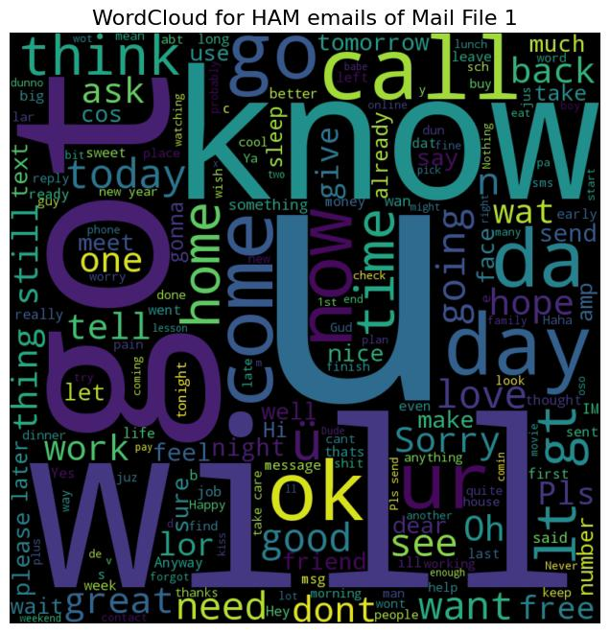
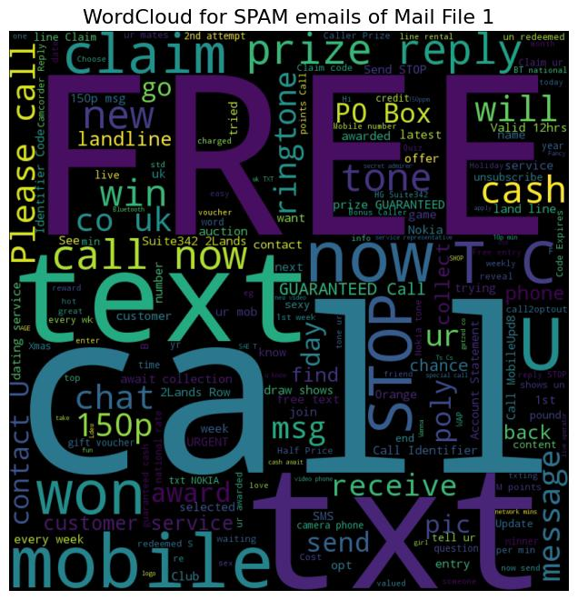

Slide 10
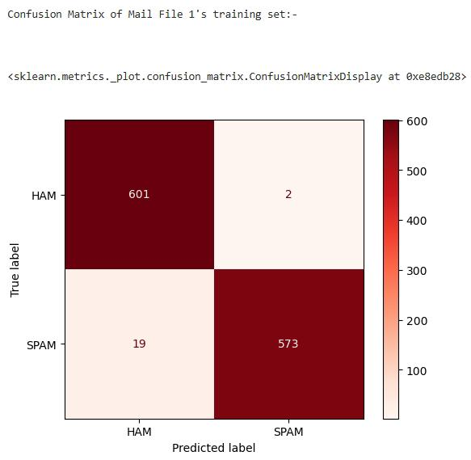
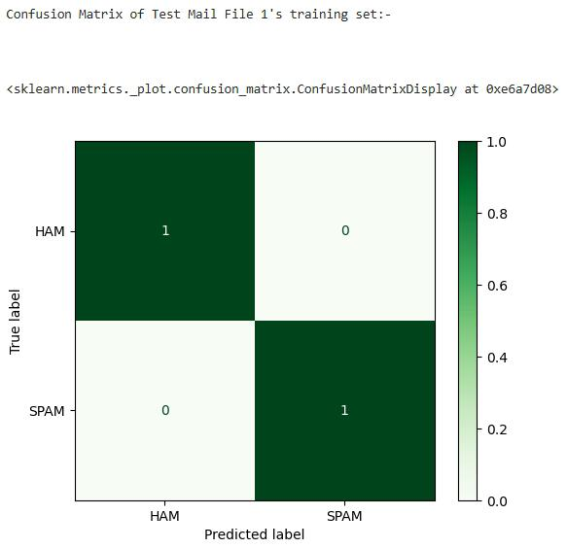


Slide 11
Conclusion
As it may be seen from the evaluation scores alongside, the model is highly effective and efficient defecting spam mails and differentiating them from ham mails with high accuracy. The model may thus be considered ready for practical usage on real-time samples.
No challenges were encountered during the implementation of the algorithm to create, train, and test the model and evaluate its performance. It was a smooth process with ample resources.
Due to the good evaluation scores, it may be said that the proposed solution was very effective in building a proper functioning model. Aadditionally, as the data was also clean and balanced and due to the feature engineering, the model was able to perform well and deliver satisfactory results.
In future, this model can be fine-tuned and special techniques can be used in order to make it even more robust and accurate.
Spam mails can be efficiently utilized by cybercriminals to set up and harm others in many dangerous ways and destroy the future of several innocent people. It is thus extremely important for the model to be able to predict spam mails and differentiate them from ham mails absolutely correctly.
MODEL EVALUATION SCORES
TRAINING SUBSETS | MAIL FILE 1 | MAIL FILE 2 | MAIL FILE 3 | TEST MAIL FILE 1
ACCURACY SCORE | 0.9824 | 0.9958 | 0.9840 | 1.0
MAE | 0.0175 | 0.0041 | 0.0159 | 0.0
MSE | 0.0175 | 0.0041 | 0.0159 | 0.0
RMSE | 0.1325 | 0.0646 | 0.1263 | 0.0
F1 SCORE | 0.98 | 1.00 | 0.98 | 1.00
TESTING SUBSETS | MAIL FILE 1 | MAIL FILE 2 | MAIL FILE 3 | TEST MAIL FILE 1
ACCURACY SCORE | 0.9464 | 0.9805 | 0.9716 | 1.0
MAE | 0.0535 | 0.0194 | 0.0283 | 0.0
MSE | 0.0535 | 0.0194 | 0.0283 | 0.0
RMSE | 0.2313 | 0.1396 | 0.1684 | 0.0
F1 SCORE | 0.95 | 0.98 | 0.97 | 1.00

Slide 12
Future scope
Leveraging advancements in deep learning to incorporate user feedback and enhancing accuracy and efficiency.
Fine tuning the model for better performance.
Using hybrid models that combine different machine learning algorithms to create more robust models.
Imroving the model's speed and also maintaining the efficiency.
Usinging the model to detect spam messages in other forms of online communication, such as social media and messaging apps.

Slide 13
References
Project link:-
GitHub: https://github.com/PERSONAL-PROJECTS-2000/ClassificationOfEmailsAsHamOrSpam
Links to the sources of reference material used for this project:-
https://github.com/thoufiqz55/Medical_charges
https://github.com/thoufiqz55/Auctioned_car
https://github.com/therohitshelar97/SignLanguageDetectionDeepLearningProject.git
https://youtu.be/FkF2jhaRJIs?si=UhvorVDyxMwIVN1C
https://www.geeksforgeeks.org/detecting-spam-emails-using-tensorflow-in-python/
https://github.com/mlevin65/INST414.git
https://www.geeksforgeeks.org/understanding-logistic-regression/
https://www.geeksforgeeks.org/how-to-calculate-mean-absolute-error-in-python/
https://www.geeksforgeeks.org/f1-score-in-machine-learning/
https://www.datacamp.com/tutorial/markdown-in-jupyter-notebook.
Links to datasets:-
Mail File 1: https://drive.google.com/drive/u/0/mobile/folders/1bRuM2RJ3CGD5_PtnIr7jVbC5kOJW5o6x?usp=sharing
Mail File 2: https://www.kaggle.com/datasets/noeyislearning/spam-emails
Mail File 3: https://www.kaggle.com/datasets/bayes2003/emails-for-spam-or-ham-classification-trec-2006?resource=download&select=email_text.csv
Test Mail File 1: https://www.kaggle.com/datasets/devildyno/email-spam-or-not-classification

Slide 14
Thank you

